Slide 1

Divide & Conquer Strategy
General Method, Finding the maximum and minimum, Merge Sort, Quick Sort

Slide 2
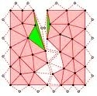
Divide And Conquer Method
General Method
Finding the maximum and minimum
Binary Search
Merge Sort
Quick Sort

Slide 3
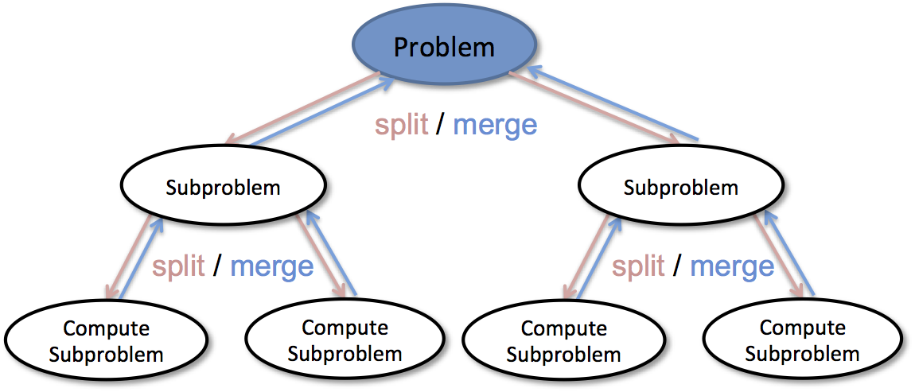
General Method

Slide 4
General Concept of Divide & Conquer
Given a function to compute on n inputs, the divide-and-conquer strategy consists of:
splitting the inputs into k distinct subsets, 1<k≤n, yielding k subproblems.
solving these subproblems
combining the subsolutions into solution of the whole.
if the subproblems are relatively large, then divide_Conquer is applied again.
if the subproblems are small, the are solved without splitting.

Slide 5
The Divide and Conquer Algorithm
Divide_Conquer(problem P)
{
if Small(P) return S(P);
else {
divide P into smaller instances P₁, P₂, …, P_{k}, k≥1;
Apply Divide_Conquer to each of these subproblems;
return Combine(Divide_Conque(P₁), Divide_Conque(P₂),…, Divide_Conque(P_{k}));
}
}

Slide 6
Divde_Conquer recurrence relation
The computing time of Divide_Conquer is
T(n) is the time for Divide_Conquer on any input size n.
g(n) is the time to compute the answer directly (for small inputs)
f(n) is the time for dividing P and combining the solutions.
n small
otherwise

Slide 7
Three Steps of The Divide and Conquer Approach
The most well known algorithm design strategy:
Divide the problem into two or more smaller subproblems.
Conquer the subproblems by solving them recursively.
Combine the solutions to the subproblems into the solutions for the original problem.

Slide 8
A Typical Divide and Conquer Case
a problem of size n
subproblem 1
of size n/2
subproblem 2
of size n/2
a solution to
subproblem 1
a solution to
subproblem 2
a solution to
the original problem

Slide 9
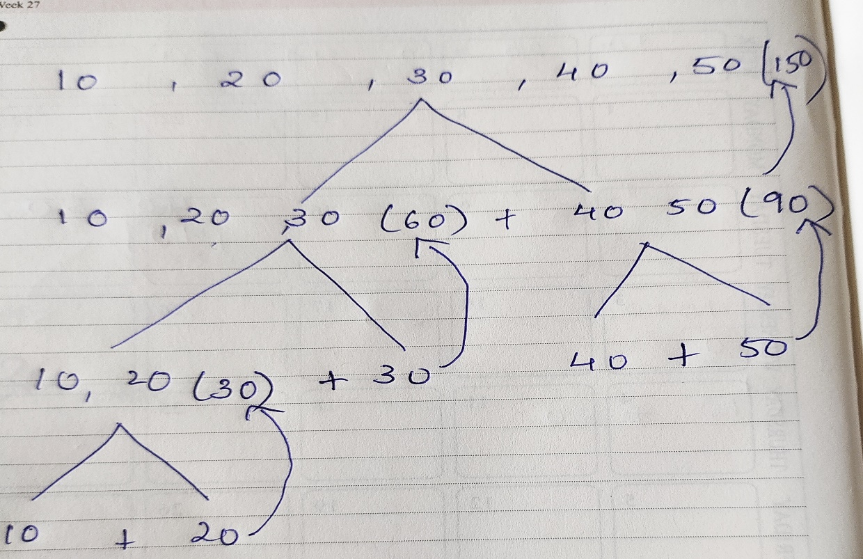
An Example: Calculating a₀ + a₁ + … + a_{n-1}
ALGORITHM RecursiveSum(A[0..n-1])
//Input: An array A[0..n-1] of orderable elements
//Output: the summation of the array elements
if n > 1
return ( RecursiveSum(A[0.. n/2 – 1]) + RecursiveSum(A[n/2 .. n– 1]) )
_{Efficiency: (for n = 2}^{k}₎
_{A(n) = 2A(n/2) + 1, n >1}
_{A(1) = 1;}

Slide 10
_{A(n) = 2A(n/2) + 1, n >1}
_{A(1) = 1;}
A(n) = 2A(n/2) + 1
= 2[2A(n/4)+1] + 1
= 4A(n/4)+2 + 1
= 4[2A(n/8)+1]+2 + 1
= 8A(n/8)+4+2 + 1
= 2³A(n/2³)+2²+2 + 1
= 2³A(n/2³)+2²+2 + 1 …
= 2^{k}A(n/2^{k})+2^{k-1}+…+2 + 1
for A(1), n/2^{k}=1 => n= 2^{k}
= 2^{k}+2^{k-1}+…+2 + 1
2^{k}+2^{k-1}+…+2 + 1= 2^{k +1}-1
= 2^{k+1} -1 = 2^{k} .2(-1)=2n-1=O(n)

Slide 11
Solving Recurrence Equations
Substitution method
Forward
Uses initial condition in the initial term and generates next term.
Repeated until some formula is guessed
Backward
Values are substituted recursively to derive some formula
Master’s Method

Slide 12
Recurrence Relation
Equation that defines a sequence recursively
Eg1: T(n)=T(n-1)+n, n>0 Recurrence relation
T(0)=0 Initial Condition
Eg2:f(n)= 2f(n-1)+1 for n>1
f(0)=0, Solve the recurrence relation

Slide 13
Substitution Method
T(n)=T(n-1)+n, n>0 Recurrence relation
T(0)=0, n<=0 Initial Condition
Forward Substitution Backward Substitution
T(n)=T(n-1)+n
T(n)=T(n-1)+n
T(0)=0
=[T(n-2)+n-1]+n
T(1)=T(0)+1= 0+1
=[T(n-3)+n-2]+(n-1)]+n …
T(2)=T(1)+2= 0+1+2
=[T(n-k)+n-(k-1)]+…(n-2)+(n-1)+n
T(3)=T(2)+3= 0+1+2+3 …
If it terminates at the kth step i.e n-k=0
T(n)=T(n-1)+n= 0+1+2+3+…n
=T(n-k)+n-(k-1)+…(n-2)+(n-1)+n
T(n)=0+1+2+3+…n=n*(n+1)/2=O(n²)
=T(0)+1+2+…(n-2)+(n-1)+n
=0+1+2+…(n-2)+(n-1)+n
=n*(n+1)/2= O(n²)

Slide 14
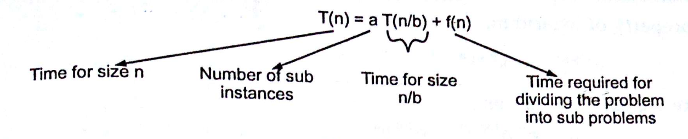
The Master Method
The master method is used to solve recurrences of the type T(n)=aT(n/b)+f(n) where a>=1 and b>1
The complexity of the divide and conquer algorithms is given by recurrences of the form
T(n)={T(1) n=1
{aT(n/b) + f(n) n>1
Where a and b are constants
We assume that T(1) is known and n is a power of b that is n=b^k.

Slide 15
General Divide and Conquer recurrence
The Master Theorem
T(n) = aT(n/b) + f (n), where f (n) ∈ Θ(n^{k})
Master Theorem can be stated for efficiency analysis as:
a < b^{k} T(n) ∈ Θ(n^{k})
a = b^{k} T(n) ∈ Θ(n^{k} lg n )
a > b^{k} T(n) ∈ Θ(n^{log} _{b}ª)
the time spent on solving a subproblem of size n/b.
the time spent on dividing the problem
into smaller ones and combining their solutions.
Solve the recurrence relation: T(n)=4T(n/2)+n
Notes:
This is the same slide from chapter 2 (analysis of recursive algorithms)
It is a good idea to remind students at this point and do some examples especially
if you went over this quickly and did not do examples the previous time.
Here are examples from before:
T(n) = T(n/2) + 1
T(n) = 2T(n/2) + n
T(n) = 3 T(n/2) + n
=> this last example is important to mention at some point:
Θ(n^{log}₂³)
NB: cannot “eliminate” or simplify this constant

